Slide 1

HIRING PROCESS ANALYTICS
TRAINITY PROJECT DONE BY: DIVYANI SIROHI

Slide 2

Introduction
The hiring process is a crucial function of any company, and understanding trends such as the number of rejections, interviews, job types, and vacancies can provide valuable insights for the hiring department.

Slide 3
Data Analytics Task:
1. Hiring Analysis: The hiring process involves bringing new individuals into the organization for various roles.
My Task: Determine the gender distribution of hires. How many males and females have been hired by the company
2. Salary Analysis: The average salary is calculated by adding up the salaries of a group of employees and then dividing the total by the number of employees.
My Task: What is the average salary offered by this company? Use Excel functions to calculate this.
3. Salary Distribution: Class intervals represent ranges of values, in this case, salary ranges. The class interval is the difference between the upper and lower limits of a class.
My Task: Create class intervals for the salaries in the company. This will help you understand the salary distribution.
4. Departmental Analysis: Visualizing data through charts and plots is a crucial part of data analysis.
My Task: Use a pie chart, bar graph, or any other suitable visualization to show the proportion of people working in different departments.
5. Position Tier Analysis: Different positions within a company often have different tiers or levels.
My Task: Use a chart or graph to represent the different position tiers within the company. This will help you understand the distribution of positions across different tiers.

Slide 4
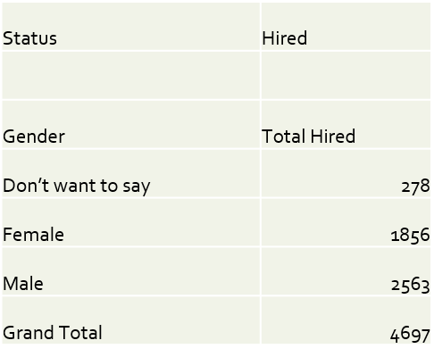
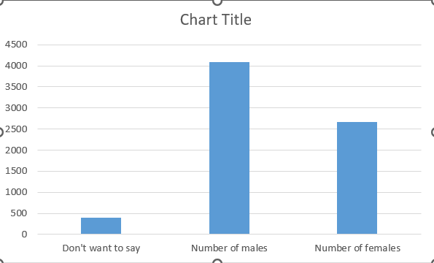
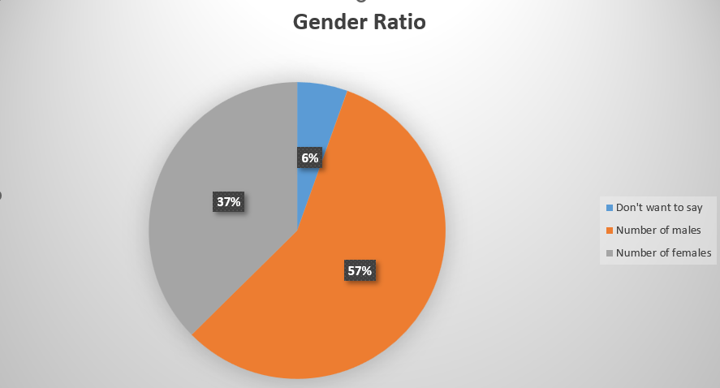
Hiring Analysis
The hiring process involves bringing new individuals into the organization for various roles.

Slide 5
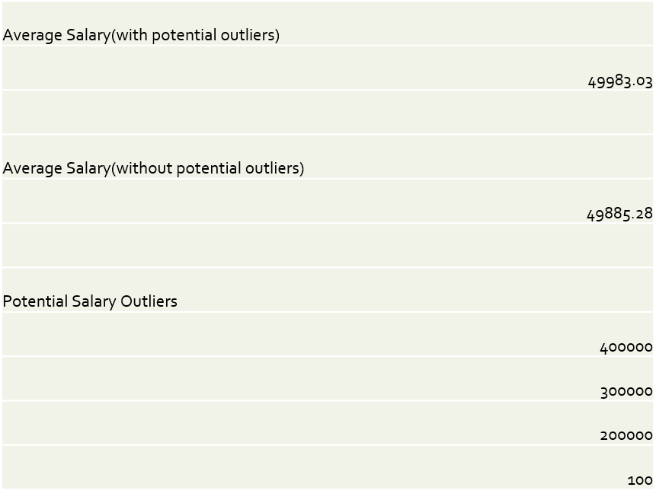
Salary Analysis
The average salary is calculated by adding up the salaries of a group of employees and then dividing the total by the number of employees.

Slide 6
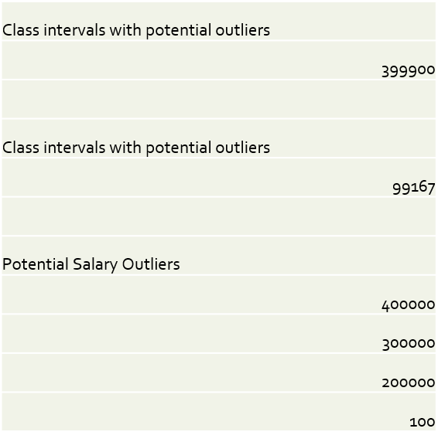
Salary Distribution

Slide 7
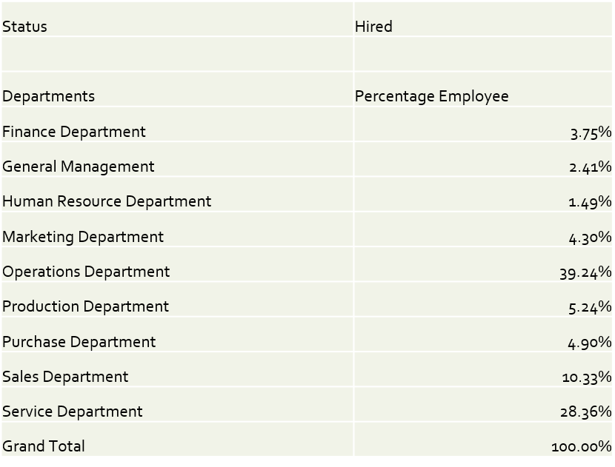
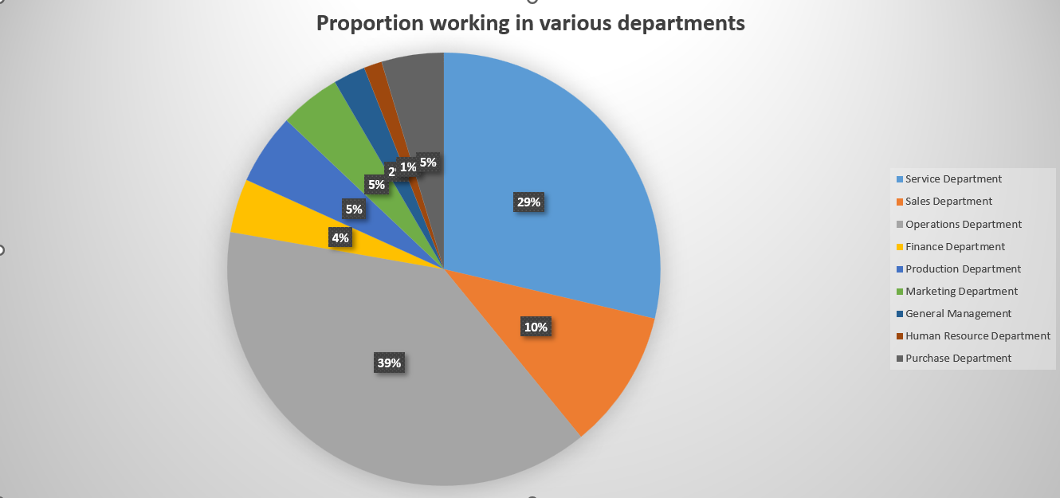
Departmental Analysis:Proportion working in Various Departments
Visualizing data through charts and plots is a crucial part of data analysis

Slide 8
Post Description(Gender wise distribution per post)

Slide 9
Position Tier Analysis

Slide 10
Position Description

Slide 11
Position Description(Proportion Workers per postion)

Slide 12
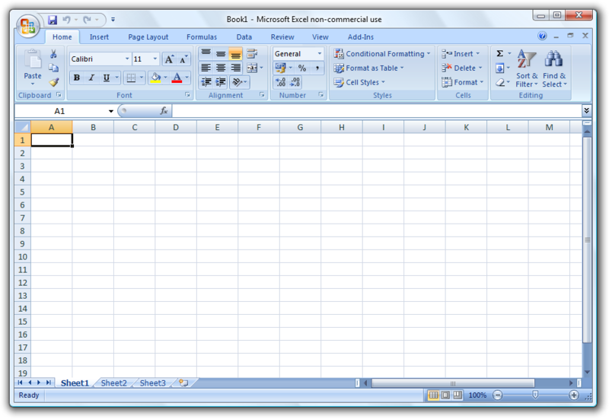
Tech- Stack Used
MS EXCEL 2022:
It is a part of the Microsoft Office suite of productivity applications.
The purpose of using Microsoft Excel 2022 is used for creating, editing, organizing, and analyzing data in tabular form.
It offers various features such as formulas, functions, charts, graphs, pivot tables, and conditional formatting, making it a versatile tool for data management and analysis across various industries and professions.

Slide 13
Result
The given project helped in gaining mastery in pivot tables, Arithmetic & Text functions basic data operations and use of some charts & functions.
This helped in establishing a strong foundation for MS Excel.

